Slide 1
Methods for Integrating EHRs, Social Determinants of Health, and Built Environment Data for Patient-Centered Research
Detection and Learning Using Multiple Data Sources
S114
Joseph Deferio, MPH
Weill Cornell Medicine
Twitter: @diaferiaj

Slide 2
Acknowledgments
Evan Sholle, MS Weill Cornell Medicine
Kathleen G. Lee, MPH Weill Cornell Medicine
John Michael Meddar CUNY City Tech
Mohammad Tayarani, PhD Cornell University
H. Oliver Gao, PhD, MS Cornell University
Jyotishman Pathak, PhD Weill Cornell Medicine

Slide 3
Disclosure
My colleagues and I have no relevant relationships with commercial interests to disclose

Slide 4
Learning Objectives
After participating in this session the learner should be better able to:
Conceptualize linkage of external datasets with electronic health records
Improve their understanding of the application and potential utility of social determinants of health (SDOH) in patient-centered research.

Slide 5
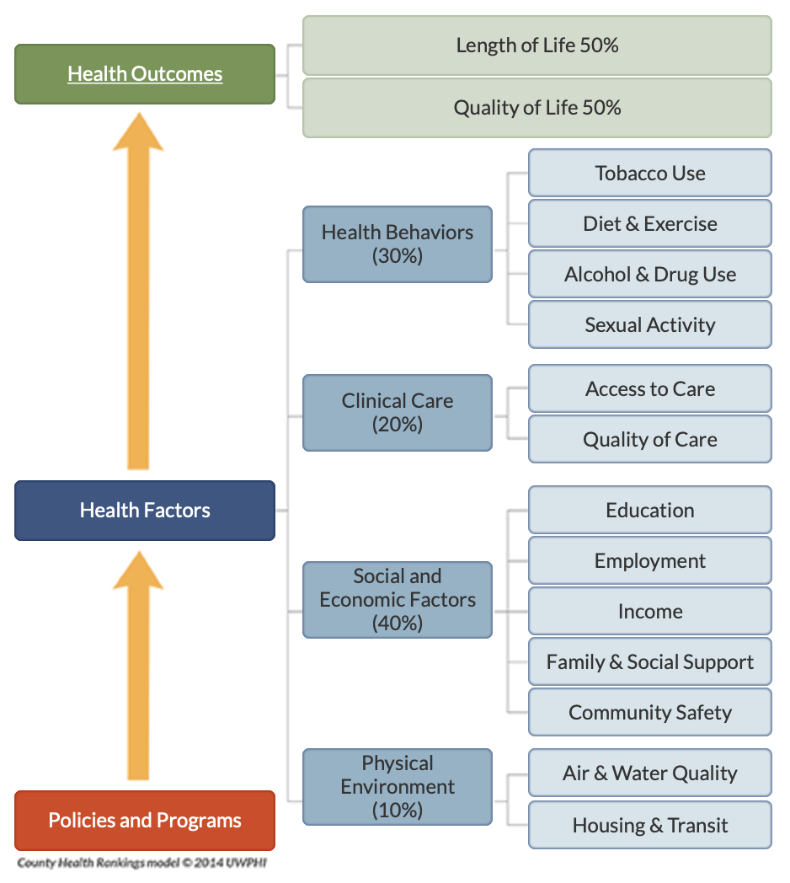
Why Social Determinants?
According to this recent framework, social and economic factors may contribute up to 40% of health outcomes
County Health Rankings. University of Wisconsin Population Health Institute. http://www.countyhealthrankings.org/explore-health-rankings/what-and-why-we-rank

Slide 6


Slide 7

Health and wellness-related data is becoming more ubiquitous electronically
No longer limited to clinical settings
data on the physical, social (and digital!) environments is coming to the fore

Slide 8
Collectively, this data is often referred to as ‘social determinants of health’ or SDOH
Digital / Online behavior (ie. social media)
Weather, air quality, and environmental factors
Interpersonal interaction (ie. crime reports)
Fitness and activity trackers

Slide 9
Collectively, this data is often referred to as ‘social determinants of health’ or SDOH
Digital / Online behavior (ie. social media)
Weather, air quality, and environmental factors
Interpersonal interaction (ie. crime reports)
Fitness and activity trackers
Better yet, they should be referred to as ‘social influences of health’

Slide 10
Collectively, this data is often referred to as ‘social determinants of health’ or SDOH
Digital / Online behavior (ie. social media)
Weather, air quality, and environmental factors
Interpersonal interaction (ie. crime reports)
Fitness and activity trackers
Better yet, they should be referred to as ‘social influences of health’
We all know that our neighborhoods and communities (physical and/or digital) influence our lives. But…

Slide 11
Collectively, this data is often referred to as ‘social determinants of health’ or SDOH
Digital / Online behavior (ie. social media)
Weather, air quality, and environmental factors
Interpersonal interaction (ie. crime reports)
Fitness and activity trackers
Better yet, they should be referred to as ‘social influences of health’
We all know that our neighborhoods and communities (physical and/or digital) influence our lives. But
z
How do they influence us?
What is the magnitude of that influence?
y
x

Slide 12
Motivations
Our work was motivated by past work that has investigated the influence of one’s environment on health outcomes:
Notes:
1: Melis G, Gelormino E, Marra G, Ferracin E, Costa G. The Effects of the Urban Built Environment on Mental Health: A Cohort Study in a Large Northern Italian City. Int J Environ Res Public Health. 2015;12(11):14898-915.
2: Christine PJ, Auchincloss AH, Bertoni AG, Carnethon MR, Sanchez BN, Moore K, et al. Longitudinal Associations Between Neighborhood Physical and Social Environments and Incident Type 2 Diabetes Mellitus: The Multi-Ethnic Study of Atherosclerosis (MESA). JAMA internal medicine. 2015;175(8):1311-20.

Slide 13
Motivations
Our work was motivated by past work that has investigated the influence of one’s environment on health outcomes:
One study concluded that access to public transportation and dense urban structure could reduce risk of depression¹
Notes:
1: Melis G, Gelormino E, Marra G, Ferracin E, Costa G. The Effects of the Urban Built Environment on Mental Health: A Cohort Study in a Large Northern Italian City. Int J Environ Res Public Health. 2015;12(11):14898-915.
2: Christine PJ, Auchincloss AH, Bertoni AG, Carnethon MR, Sanchez BN, Moore K, et al. Longitudinal Associations Between Neighborhood Physical and Social Environments and Incident Type 2 Diabetes Mellitus: The Multi-Ethnic Study of Atherosclerosis (MESA). JAMA internal medicine. 2015;175(8):1311-20.

Slide 14
Motivations
Our work was motivated by past work that has investigated the influence of one’s environment on health outcomes:
One study concluded that access to public transportation and dense urban structure could reduce risk of depression¹
Another study concluded that long-term exposure to environments that support physical activity and healthy diets is associated with lower incidence of type-2 diabetes²
Notes:
1: Melis G, Gelormino E, Marra G, Ferracin E, Costa G. The Effects of the Urban Built Environment on Mental Health: A Cohort Study in a Large Northern Italian City. Int J Environ Res Public Health. 2015;12(11):14898-915.
2: Christine PJ, Auchincloss AH, Bertoni AG, Carnethon MR, Sanchez BN, Moore K, et al. Longitudinal Associations Between Neighborhood Physical and Social Environments and Incident Type 2 Diabetes Mellitus: The Multi-Ethnic Study of Atherosclerosis (MESA). JAMA internal medicine. 2015;175(8):1311-20.

Slide 15
Now, more than ever, health systems can begin to answer some of these questions!

Slide 16
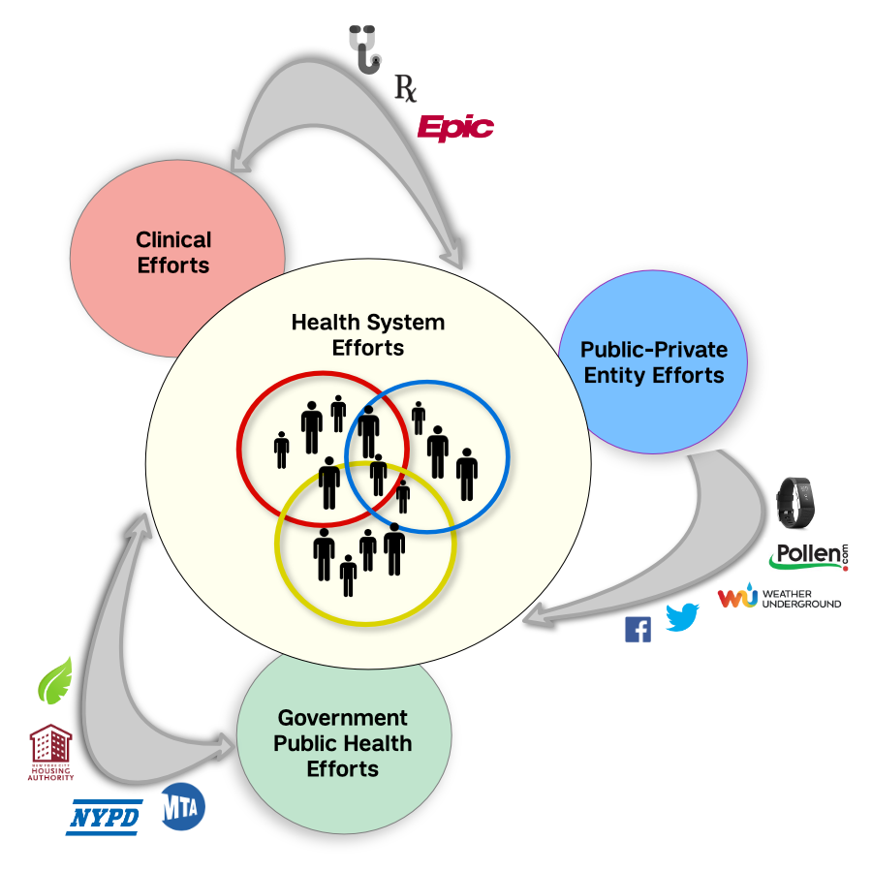
Now, more than ever, health systems can begin to answer some of these questions!
Health Systems have access to:
Patient health records
Publicly available data
Public-private entities
Government-collected
Informatics and data science teams

Slide 17
Objectives
Primary:
To address this knowledge gap and achieve a more comprehensive EHR data integration and linkage that incorporates a broad spectrum of information about SDOH and built environment across NYC
Secondary:
To examine risk/protective socio-ecological factors for psychiatric hospitalization in NYC

Slide 18

Notes:
Cantor MN, Chandras R, Pulgarin C. Facets: Using open data to measure community social determinants of health. J Am Med Inform Assoc. 2017.

Slide 19
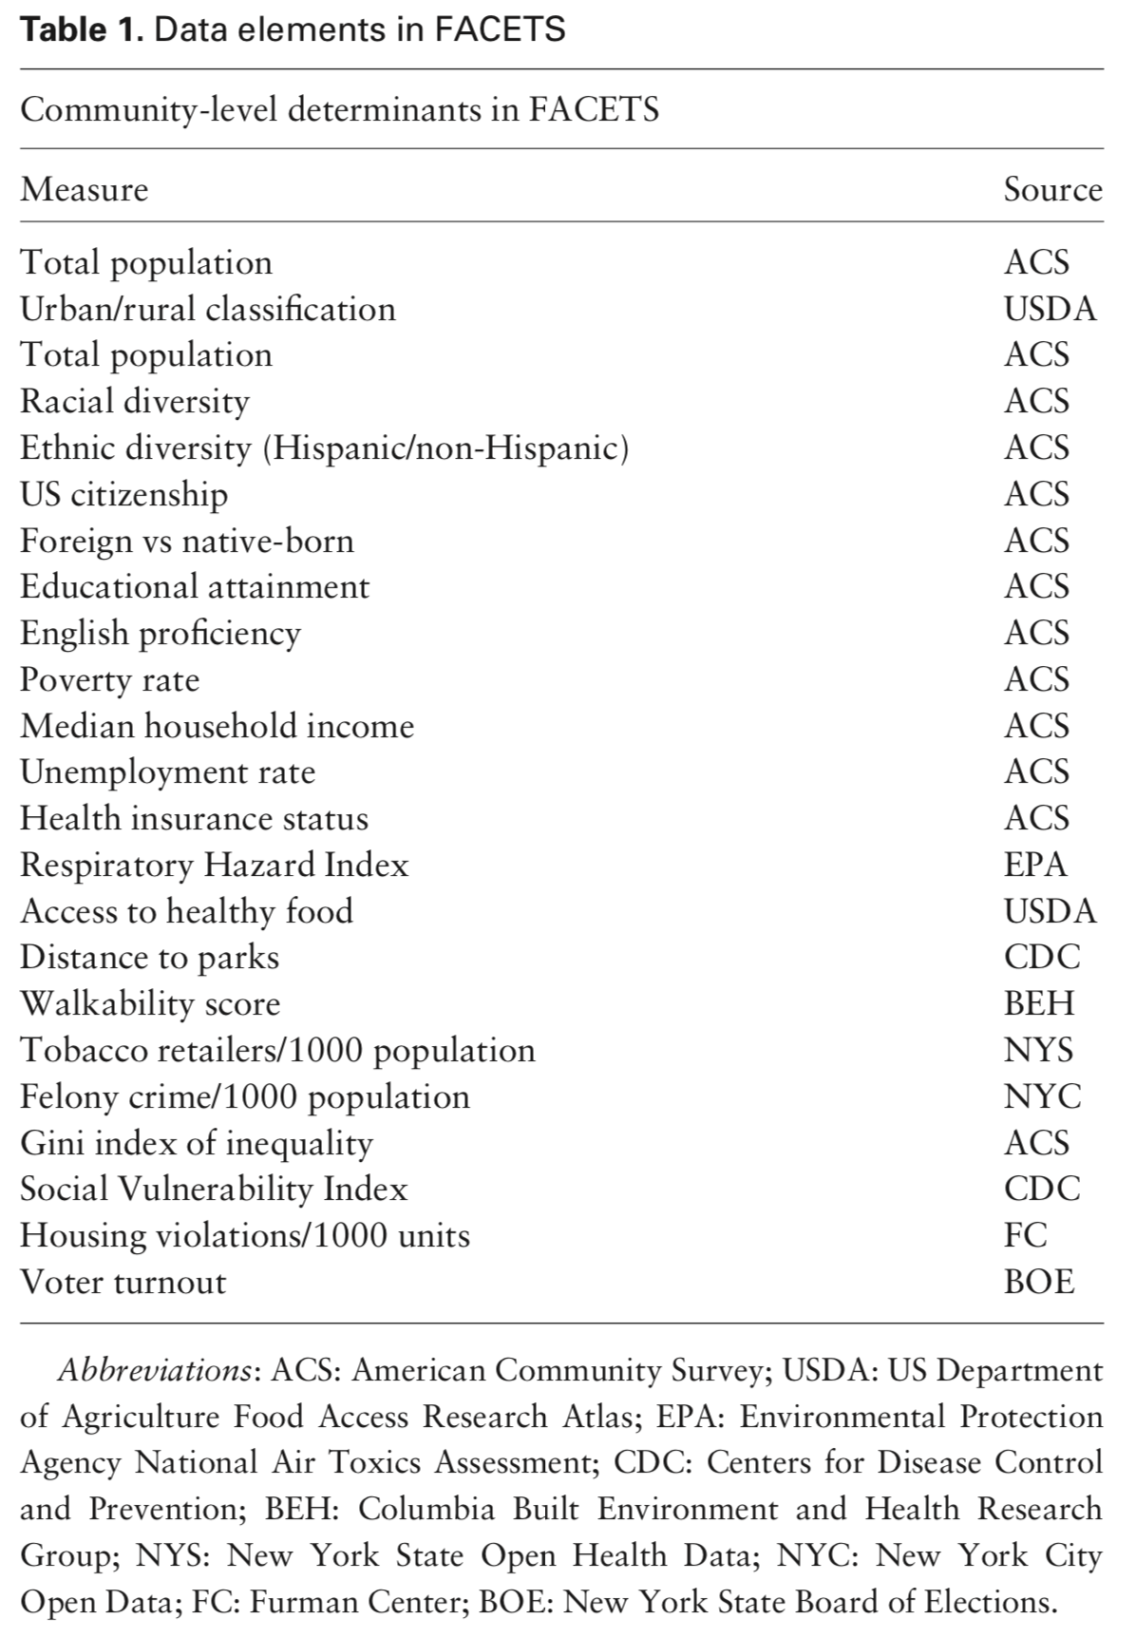
Census tract-level data from:
American Community Survey
Centers for Disease Control and Prevention
NYC Open Data
NY State Board of Election

Slide 20
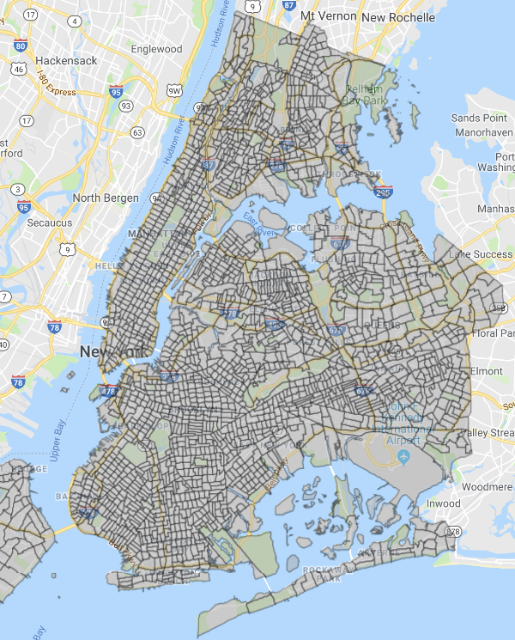
2010 NYC Census Tracts
N = 2165
Each tabulation area has 11-digit FIPS code correlating to state, county, and census tract
Ex. 36061011000

Slide 21
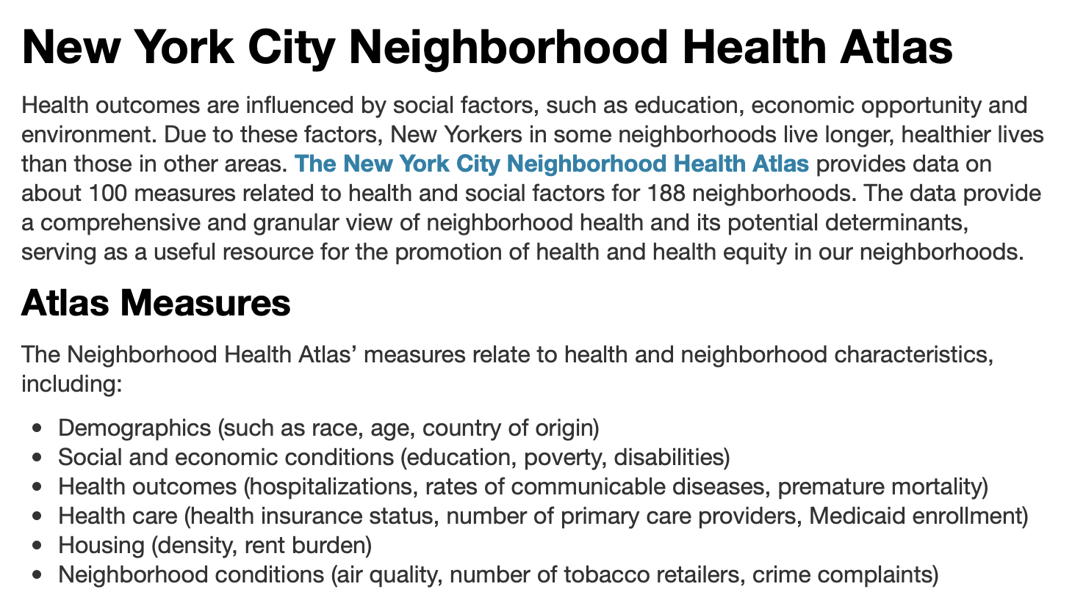

Slide 22
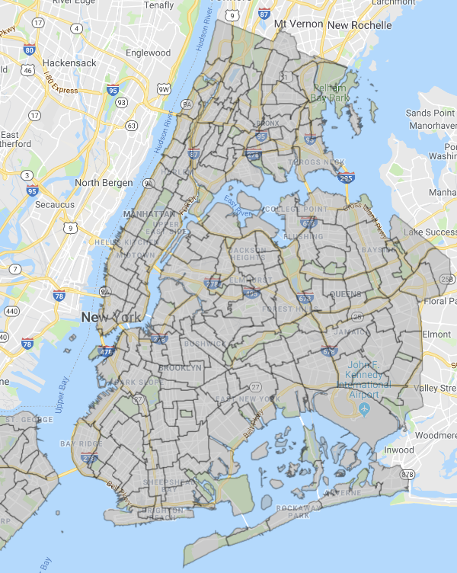
NYC Neighborhood Tabulation Areas (NTAs)
n = 195
NTAs are based on census tracts ∴ conversion can be done with relative ease
Ex. MN33

Slide 23
The abundance of census tract-level data led us to adopt this unit to facilitate data integration
Therefore, we sought to map patient addresses to their associated census tract FIPS codes
API
Address
11-digit FIPS code

Slide 24
First, we stripped raw address data of apartment-level identifiers and names to allow for maximum preservation of patient privacy.
John Doe | 123 E 60 St Apt 301, New York, NY 10065
Notes:
https://www.amia.org/jointsummits2017/posters

Slide 25
First, we stripped raw address data of apartment-level identifiers and names to allow for maximum preservation of patient privacy.
John Doe | 123 E 60 St Apt 301, New York, NY 10065
ab12xz75c 123 E 60 St, New York, NY 10065
Synthetic ID
Modified Address
Notes:
https://www.amia.org/jointsummits2017/posters

Slide 26
First, we stripped raw address data of apartment-level identifiers and names to allow for maximum preservation of patient privacy.
John Doe | 123 E 60 St Apt 301, New York, NY 10065
ab12xz75c 123 E 60 St, New York, NY 10065
Synthetic ID
Modified Address
Resultant tuple was passed to the US Census Bureau API
Synthetic ID
FIPS
Result
ab12xz75c
36061011000
Notes:
https://www.amia.org/jointsummits2017/posters
https://www.census.gov/geo/maps-data/data/geocoder.html

Slide 27
What are the next steps?
In relation to our communities/neighborhoods, we can begin to assess:
How do they influence us?
What is the magnitude of that influence?

Slide 28
What are the next steps?
In relation to our communities/neighborhoods, we can begin to assess:
How do they influence us?
What is the magnitude of that influence?
We can now link community-level estimates of social determinants to individual electronic health records

Slide 29
What are the next steps?
In relation to our communities/neighborhoods, we can begin to assess:
How do they influence us?
What is the magnitude of that influence?
We can now link community-level estimates of social determinants to individual electronic health records
We can aggregate patient records to census tracts (or other zones) and perform community-level analyses with external data

Slide 30
What are the next steps?
In relation to our communities/neighborhoods, we can begin to assess:
How do they influence us?
What is the magnitude of that influence?
We can now link community-level estimates of social determinants to individual electronic health records
We can aggregate patient records to census tracts (or other zones) and perform community-level analyses with external data
We can map patient locations (while maintaining privacy!) and proximity to other features

Slide 31
What are our next steps?
Objective: predict 1st psychiatric hospitalization across NYC in 2014

Slide 32
What are our next steps?
Objective: predict 1st psychiatric hospitalization across NYC in 2014
Who: clinical data from n=1,470,242 patients aged ≥ 18 years in NYC-Clinical Data Research Network (NYC-CDRN)
n=470,242 (cases) whom have Dx depression OR Rx antidepressant
n=1,000,000 (controls) whom have no history of schizophrenia, bipolar, depression, other psychoses
Notes:
http://www.nyccdrn.org

Slide 33
What are our next steps?
Objective: predict 1st psychiatric hospitalization across NYC in 2014
Who: clinical data from n=1,470,242 patients aged ≥ 18 years in NYC-Clinical Data Research Network (NYC-CDRN)
n=470,242 (cases) whom have Dx depression OR Rx antidepressant
n=1,000,000 (controls) whom have no history of schizophrenia, bipolar, depression, other psychoses
When: diagnosis and encounter data from 2012-2014
Notes:
http://www.nyccdrn.org

Slide 34
What are our next steps?
Objective: predict 1st psychiatric hospitalization across NYC in 2014
Who: clinical data from n=1,470,242 patients aged ≥ 18 years in NYC-Clinical Data Research Network (NYC-CDRN)
n=470,242 (cases) whom have Dx depression OR Rx antidepressant
n=1,000,000 (controls) whom have no history of schizophrenia, bipolar, depression, other psychoses
When: diagnosis and encounter data from 2012-2014
Why: to see which clinical features influence predictive power, and if SDH built environment features improve prediction
Notes:
http://www.nyccdrn.org

Slide 35
What are our next steps?
Objective: predict 1st psychiatric hospitalization across NYC in 2014
Who: clinical data from n=1,470,242 patients aged ≥ 18 years in NYC-Clinical Data Research Network (NYC-CDRN)
n=470,242 (cases) whom have Dx depression OR Rx antidepressant
n=1,000,000 (controls) whom have no history of schizophrenia, bipolar, depression, other psychoses
When: diagnosis and encounter data from 2012-2014
Why: to see which clinical features influence predictive power, and if SDH built environment features improve prediction
How: supervised learning using logistic regression and 5-fold cross-validation
Notes:
http://www.nyccdrn.org

Slide 36
Inclusion / Exclusion
Limited to patients with a FIPS code for census tract
Not all NYC-CDRN sites reported this data
Removed patients with multiple FIPS codes during ‘12-14
Notes:
Our dataset was limited, so addresses were withheld and instead zip-codes were sent. Not all sites sent census tract information
2012-2014 were chosen because those are the dates in which our SDH data is predominantly represented

Slide 37
Inclusion / Exclusion
Limited to patients with a FIPS code for census tract
Not all NYC-CDRN sites reported this data
Removed patients with multiple FIPS codes during ‘12-14
Removed patients with psych hospitalizations prior to 2014
Notes:
Our dataset was limited, so addresses were withheld and instead zip-codes were sent. Not all sites sent census tract information
2012-2014 were chosen because those are the dates in which our SDH data is predominantly represented

Slide 38
Inclusion / Exclusion
Limited to patients with a FIPS code for census tract
Not all NYC-CDRN sites reported this data
Removed patients with multiple FIPS codes during ‘12-14
Removed patients with psych hospitalizations prior to 2014
Included all diagnosis and encounter data 2012-2014 < hospitalization date
Patients must have had ≥ 1 encounter between 01/2012-12/2013 & ≥ 1 encounter in 2014
Notes:
Our dataset was limited, so addresses were withheld and instead zip-codes were sent. Not all sites sent census tract information
2012-2014 were chosen because those are the dates in which our SDH data is predominantly represented

Slide 39
Inclusion / Exclusion
Limited to patients with a FIPS code for census tract
Not all NYC-CDRN sites reported this data
Removed patients with multiple FIPS codes during ‘12-14
Removed patients with psych hospitalizations prior to 2014
Included all diagnosis and encounter data 2012-2014 < hospitalization date
Patients must have had ≥ 1 encounter between 01/2012-12/2013 & ≥ 1 encounter in 2014
n_{total} = 337,165
n_{hosp} = 5,185
Notes:
Our dataset was limited, so addresses were withheld and instead zip-codes were sent. Not all sites sent census tract information
2012-2014 were chosen because those are the dates in which our SDH data is predominantly represented

Slide 40
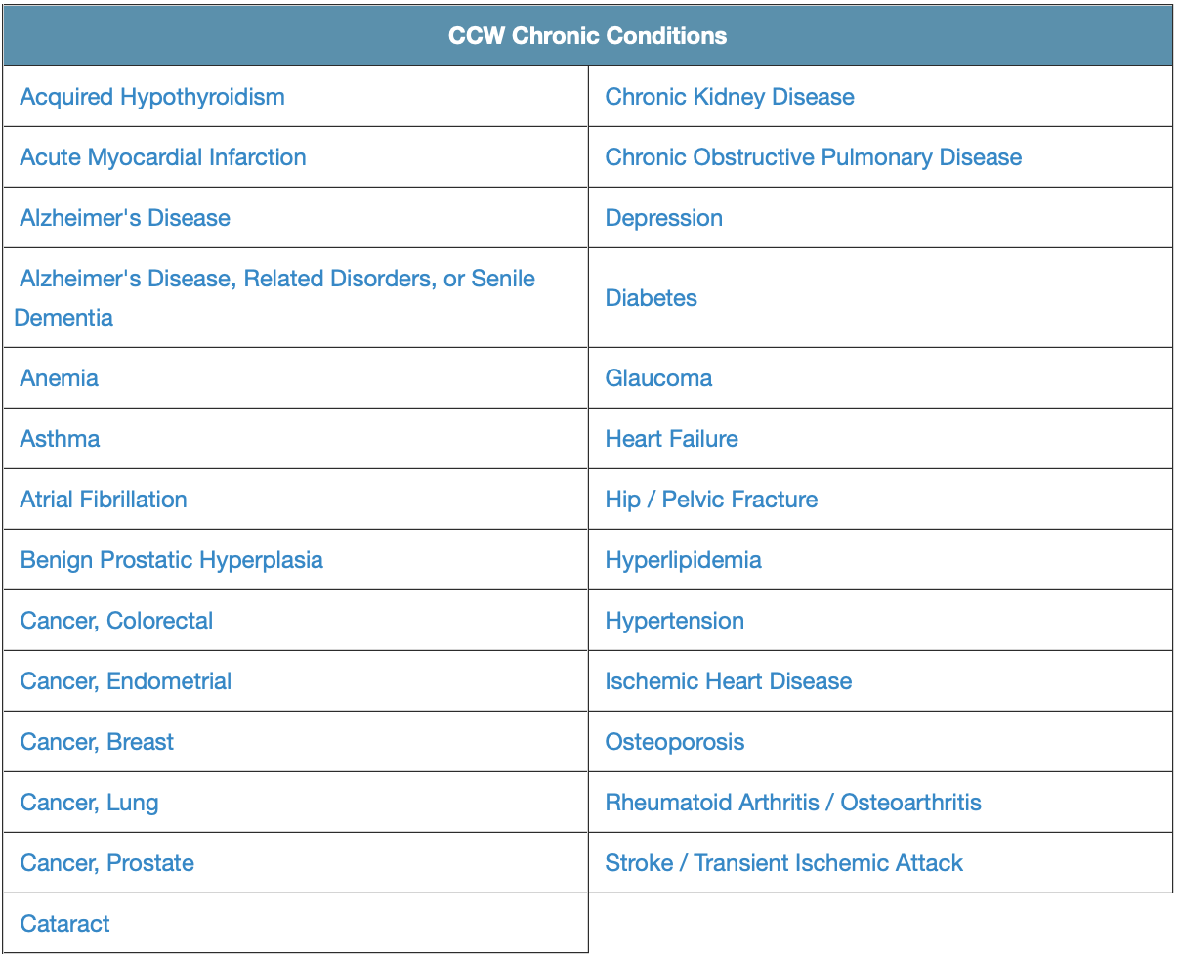
Clinical Features
CMS Chronic Conditions Data Warehouse
66 categories ⇒ representing chronic and other potentially disabling conditions
Additional features:
Drug/alcohol abuse
Injury from others/suicide
Yearly visit counts
Inpatient, Outpatient, ER, Ambulatory, Other*
Notes:
https://www.ccwdata.org/web/guest/condition-categories

Slide 41
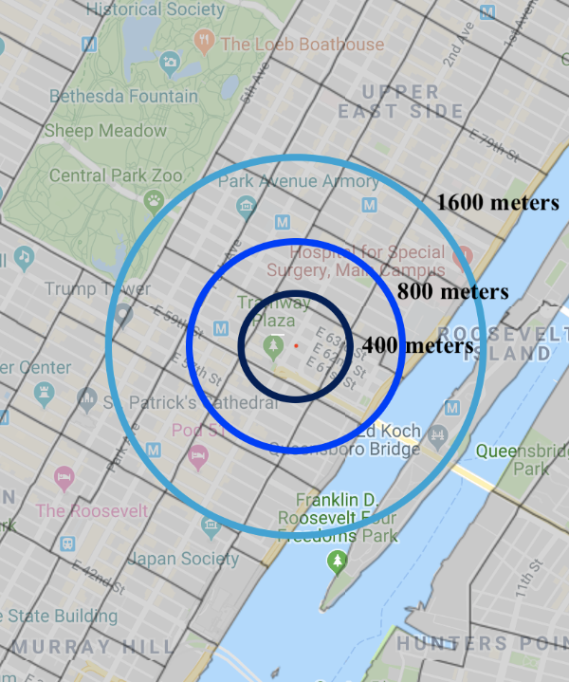
Social Determinants – Built Environment Features
Using ArcGIS, identified geographic center of each census tract
Examined SDH features that fell within 400m, 800m, and 1600m from that point
Features Include:
Public transportation
Park area
Hospitals
Cultural Centers
Museums
Schools
Maroko AR, Maantay JA, Sohler NL, Grady KL, Arno PS. The complexities of measuring access to parks and physical activity sites in New York City: a quantitative and qualitative approach. International journal of health geographics. 2009;8:34.
Notes:
Maroko AR, Maantay JA, Sohler NL, Grady KL, Arno PS. The complexities of measuring access to parks and physical activity sites in New York City: a quantitative and qualitative approach. International journal of health geographics. 2009;8:34.

Slide 42
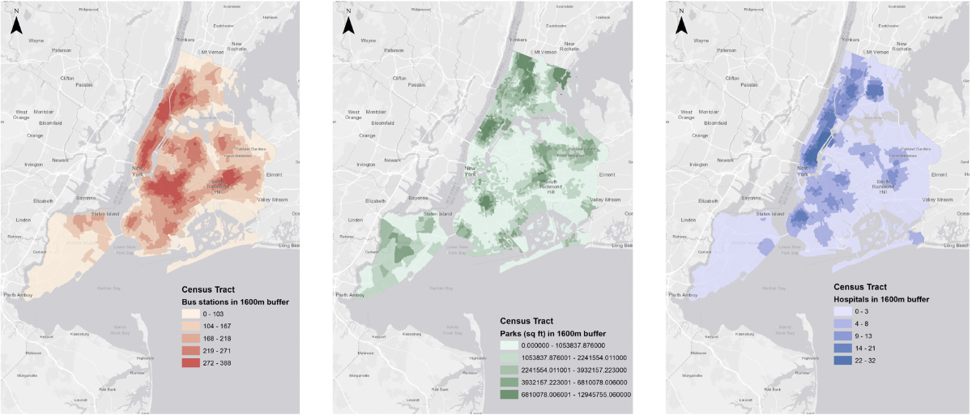
Bronx
Manhattan
Queens
Brooklyn
Staten Island

Slide 43
Preliminary Results (unpublished)
Clinical Data + 400m
SDH
Clinical Data + 1600m
SDH
Clinical Data Only
TN
FN
TN
FN
TN
FN
66,395 | 1
194 | 843
66,396 | 0
199 | 838
66,396 | 0
204 | 833
FP
TP
FP
TP
FP
TP
AUC: 0.986
Sensitivity: 0.81
Specificity: 1.00
AUC: 0.986
Sensitivity: 0.81
Specificity: 1.00
AUC: 0.985
Sensitivity: 0.80
Specificity: 1.00

Slide 44
Conclusions
External data integration can be done with relative ease
Location-based linkage of non-personal data can be a reasonable proxy for neighborhood factors
Need to develop composite measures that encompasses social and built-environment factors, such as Neighborhood Socioeconomic Status¹
ie. education, wealth, occupation, and living conditions
‘Far Too Early’ Conclusions
Built environment features do not improve prediction models for psychiatric hospitalization
Notes:
Bilal U, Hill-Briggs F, Sanchez-Perruca L, Del Cura-Gonzalez I, Franco M. Association of neighbourhood socioeconomic status and diabetes burden using electronic health records in Madrid (Spain): the HeartHealthyHoods study. BMJ open. 2018;8(9):e021143.

Slide 45
Thank you!
Email me at: jod2033@med.cornell.edu
@diaferiaj

